Slide 1


Book data Analyses Using SQL
- GANESH N KAGALE

Slide 2
BOOK DATA ANALYZE
Attract the customers
Increase sells count
Achieving goals

Slide 3
DATASET OVERVIEW
Number of Records – 1041
Numbers of fields - 15
Data – detail book information that contain author, publisher, their sales

Slide 4
Introduction :
Welcome to our book data analysis. Let's chat about different book types—what's popular, what people like, and how it might connect with what's happening in the world. compare books from different places or types to see which ones people love the most
In this dataset we have book name their publishing year and other important data. According to this data and source around 1000+ books are most popular and interesting in worldwide. The purpose of book data analyse is explore insights within our book dataset, exploring patterns, and valuable information crucial for making the right decisions.

Slide 5
Problem Statement
We know that, this era is technically developed. The selling count of all books are getting low and publisher going to bankrupt. Using this data analyse we telling to customer which book its most popular and telling publisher which author has top in selling books.

Slide 6
Data Cleaning Process
First step identifies blank values in the data Using SQL. I found that there are no missing values in table name book data.
I use index column for identifying missing values cause index column is primary key in our table. After run this query I found that there are no missing and blank values in the table

Slide 7
Finding Outliers:
"Identified outliers in book sales using IQR method, enhancing data quality for precise analysis and insights in PostgreSQL."
I use IQR Method for finding outliers in the dataset.
Using formula :
(gross_sales < Q1 - 1.5 * IQR) OR (gross_sales > Q3 + 1.5 * IQR)
On column name – gross_sales

Slide 8
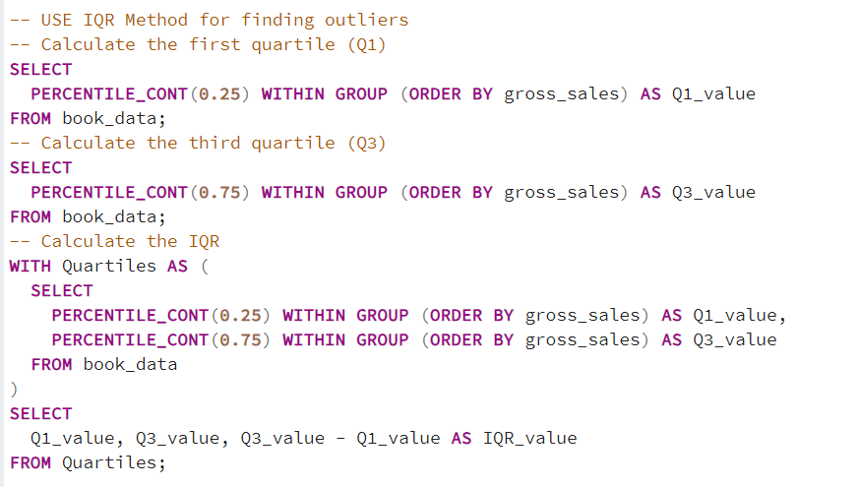
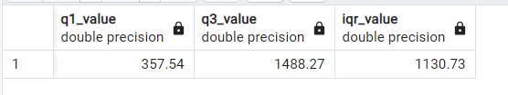

Slide 9

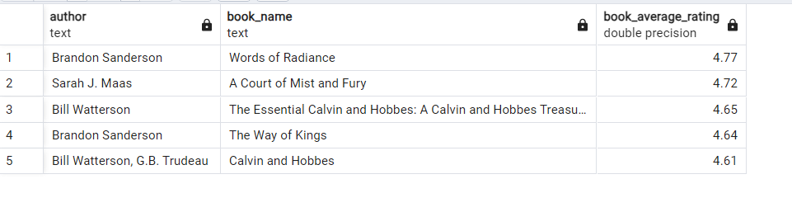
1 ) Who are the top 5 authors with the highest rating for which book ?

Slide 10
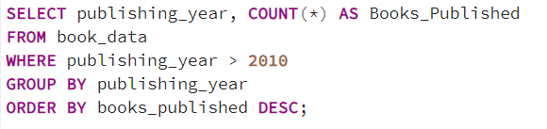
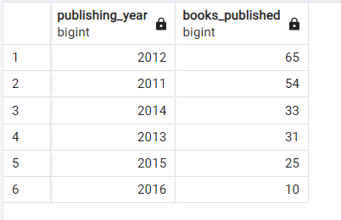
2 ) -- How many books were published after 2010 and which year the count is highest?

Slide 11
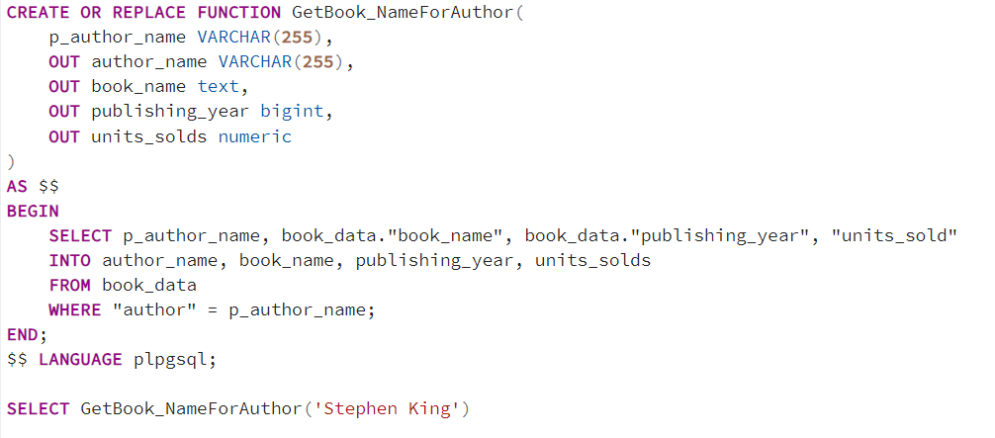
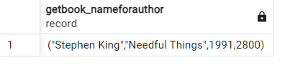
3 ) Give the list of books, along with their publishing years and units sold, written by a specific author.

Slide 12
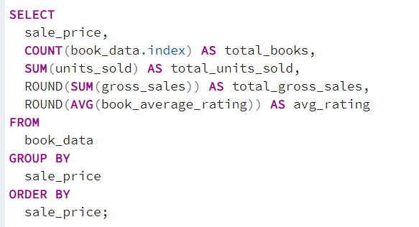
4 )Impact of book pricing on sales, revenue, and average ratings

Slide 13
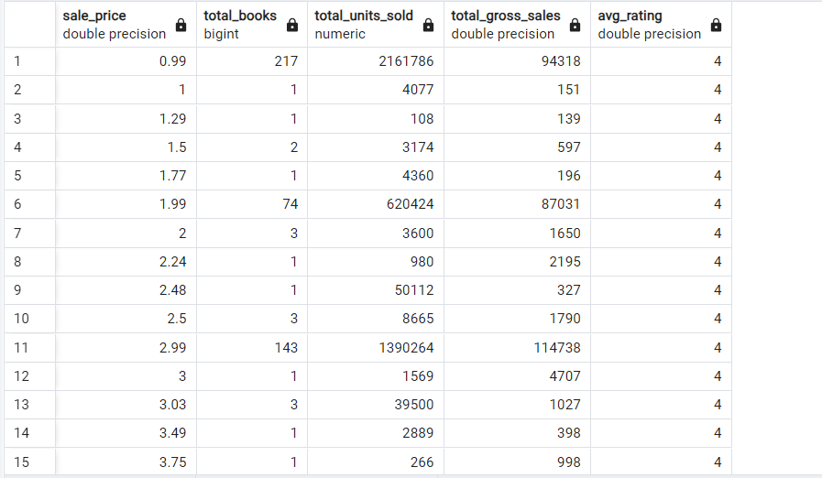

Slide 14
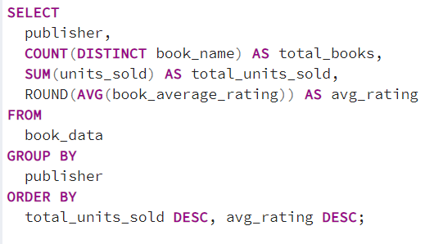
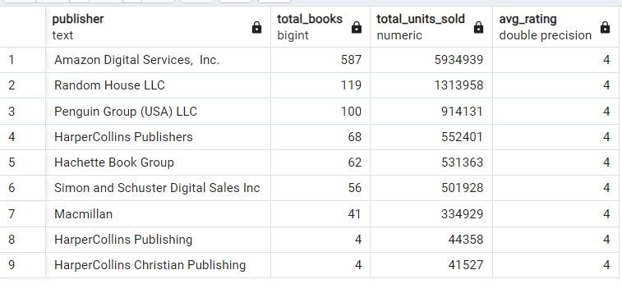
6) How much Impact on publishers on book success :

Slide 15
4 ) Insights and Recommendations :
Insights – Selling price of book is low than 5$ is on the demand.
Recommendations – Make the selling price low.
Insights – Some author makes 2/3 books per year.
Recommendations – Authors make more than 3 books per year.

Slide 16
Conclusion :
I conclude that is - authors to increase the book count. Cause I have observed that book count after 2000 is low. 2012 is highest 65 count of books in past 10 years.
Keep the sales price of books less than 2$.

Slide 17
THANK YOU

